Slide 1

A+ Guide to Managing & Maintaining Your PC, 8th Edition
Chapter 2
Working Inside a Computer
Notes:
1

Slide 2
Objectives
Learn how to take a computer apart and put it back together
Learn about the methods and devices for keeping a system cool
Learn how to select a power supply to meet the power needs of a system

Slide 3
How to Work Inside a Computer Case
Every PC technician should know how to take a computer apart and put it back together again
The following slides will cover this skill

Slide 4
Step 1: Plan and Organize Your Work
Make notes for backtracking
Remove loose jewelry that might get caught
Stay organized by keeping small parts in one place
Do not stack boards on top of each other
Do not touch board chips
With hands, magnetized screwdriver
Fingerprints on edge connectors may later cause corrosion

Slide 5
Step 1: Plan and Organize Your Work
Protect yourself and the equipment
Never ever touch inside of a turned on computer
Consider monitor, power supply as “black boxes”
Never remove the cover or touch inside
Protect against static electricity
Watch out for sharp edges that can cut

Slide 6
Step 2: Open the Computer Case and Examine the System
Back up important data
Power down the system and unplug it
Unplug other peripherals as well
Press and hold the power button for 3 seconds
This will drain the power supply
Have a plastic bag or cup handy to hold screws
Open the case cover
Many newer cases require you to remove the faceplate first
Some older cases require you to remove a side panel

Slide 7
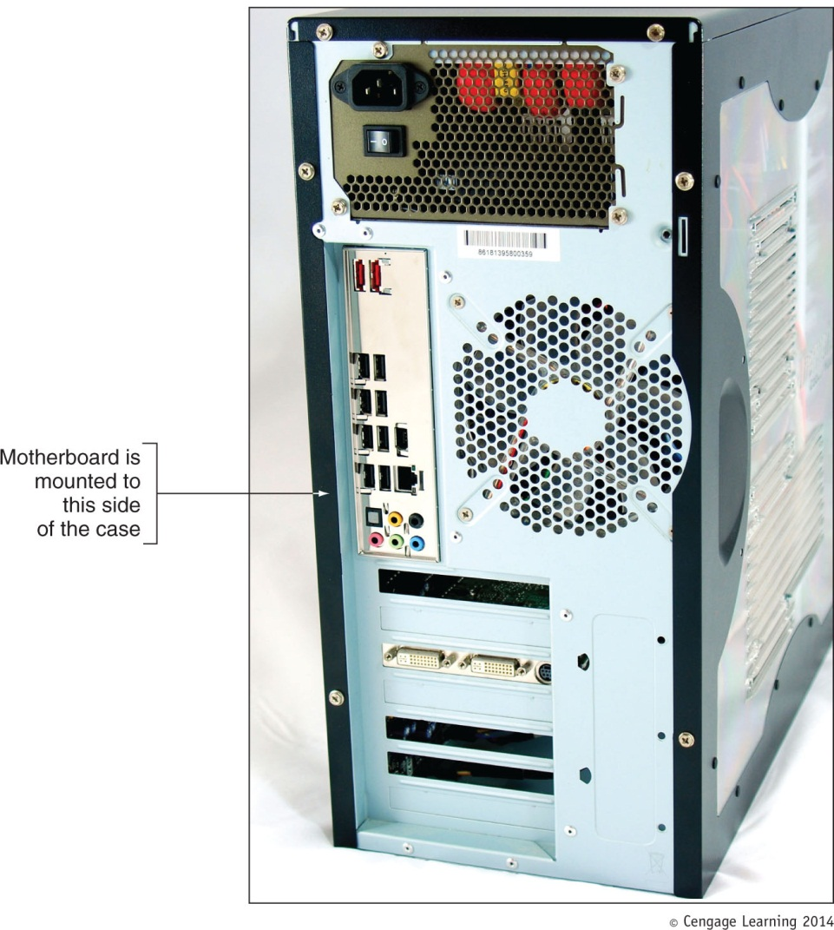
Figure 2-2 Decide which side panel to remove

Slide 8
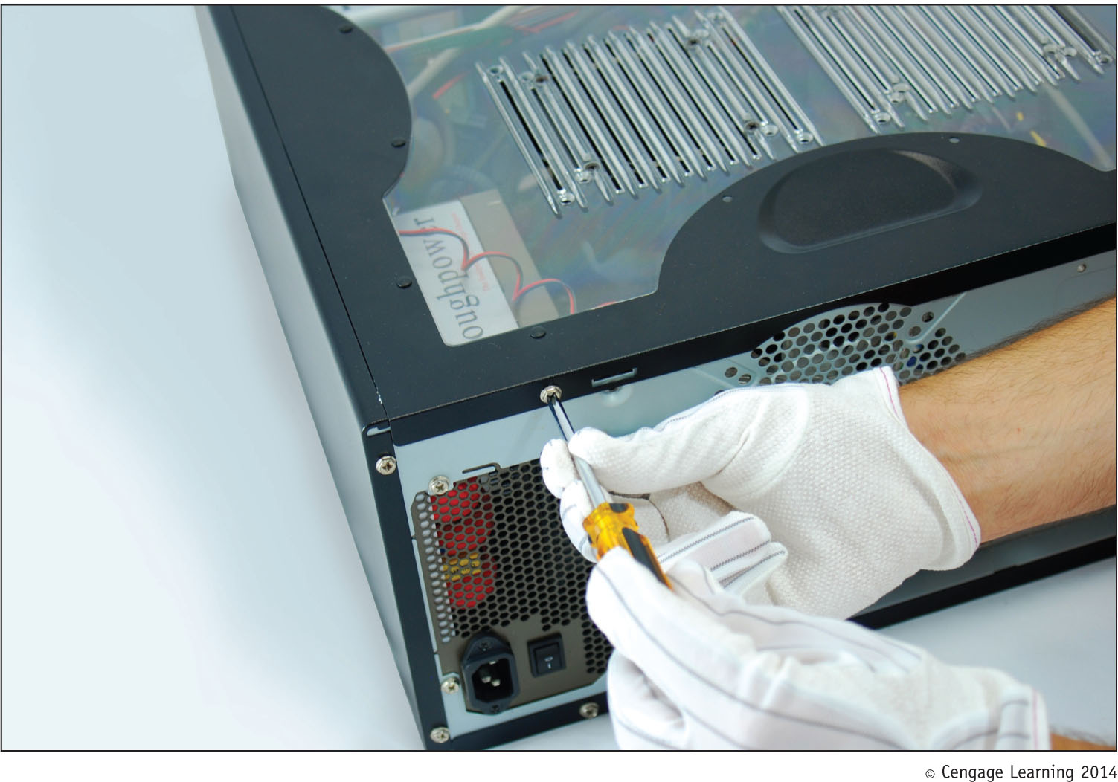
Figure 2-3 Locate the screws that hold the side panel in place

Slide 9
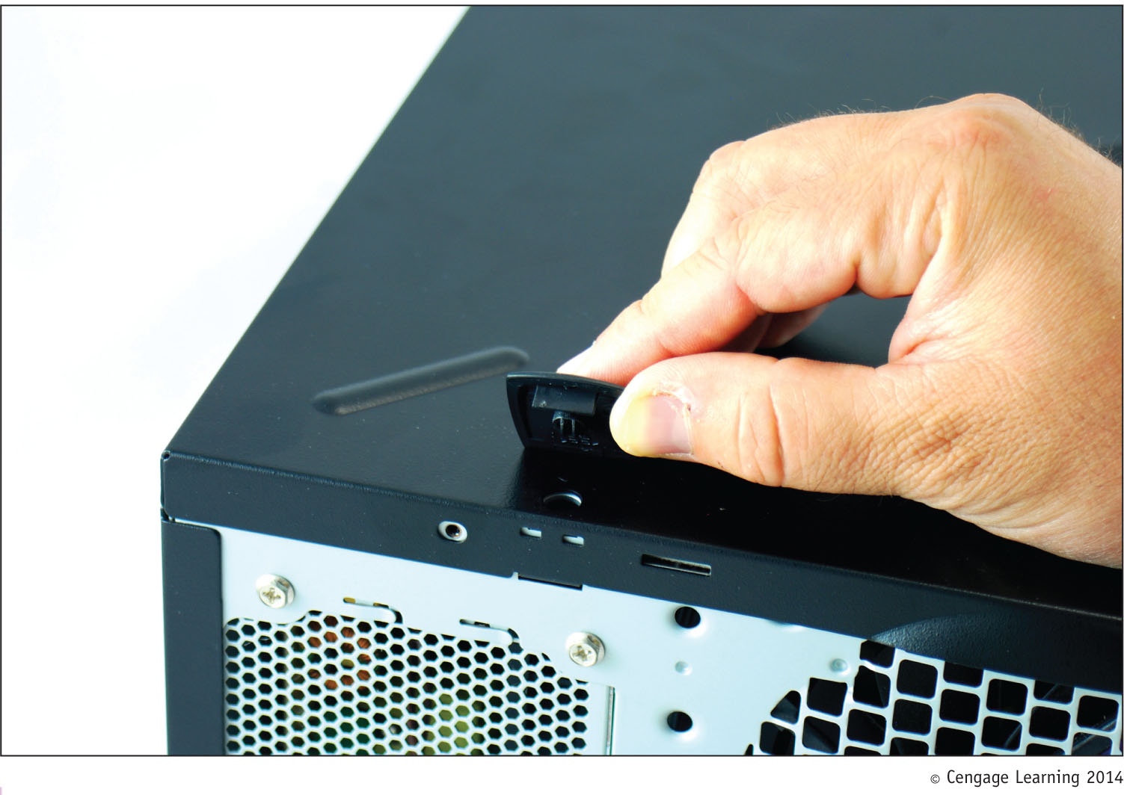
Figure 2-4 On this system, clips hold the side panel in place

Slide 10
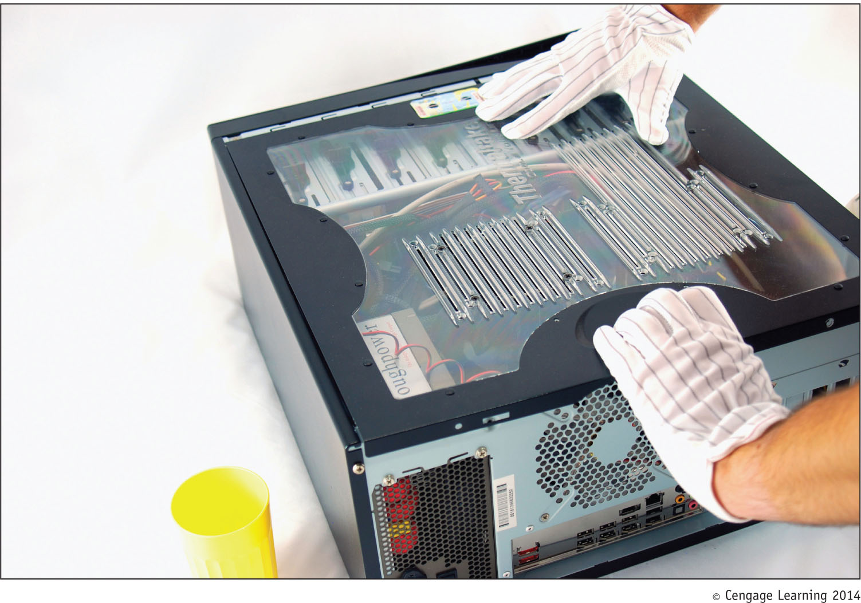
Figure 2-5 Slide the panel to the rear of the case

Slide 11
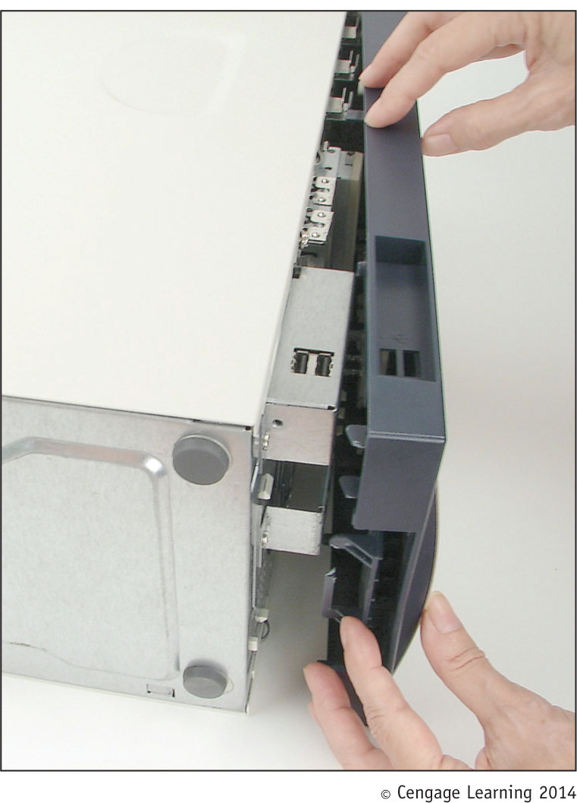
Figure 2-6 Newer cases require you to remove the front panel
before removing the side panel of a computer case

Slide 12
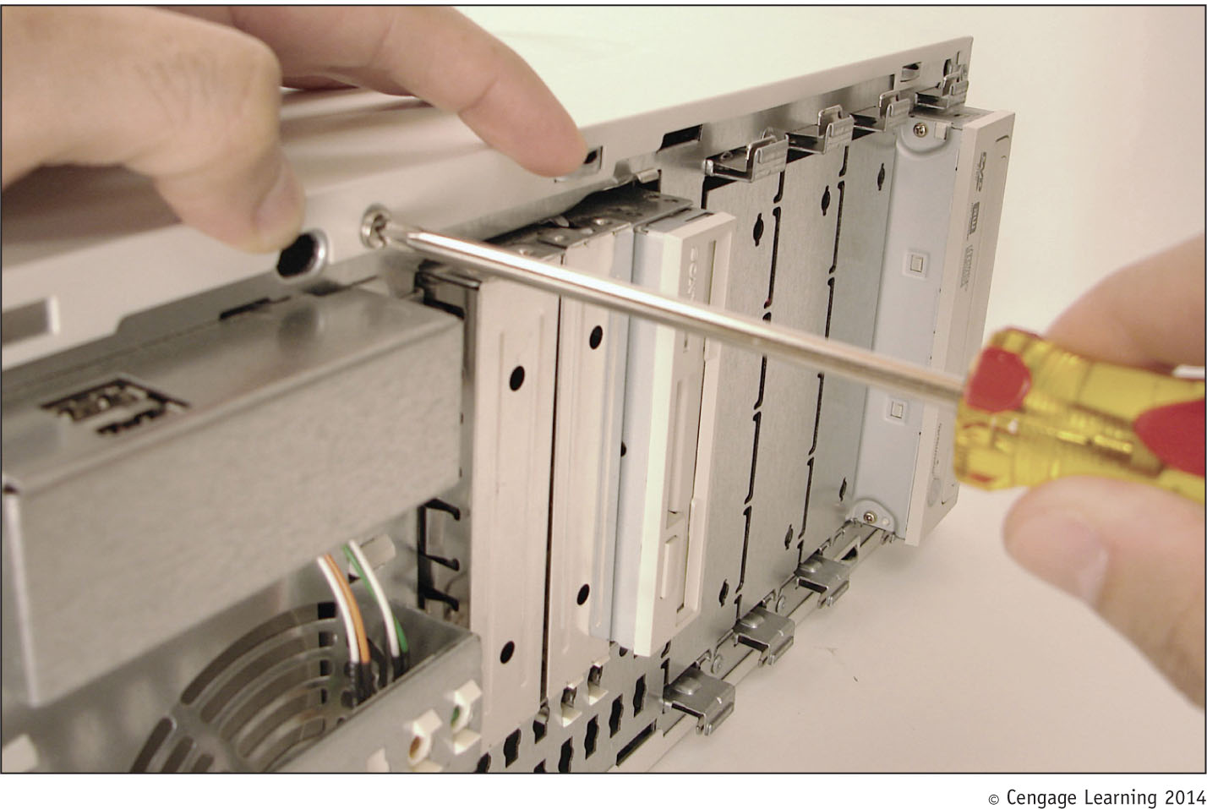
Figure 2-7 One screw holds the side panel in place

Slide 13
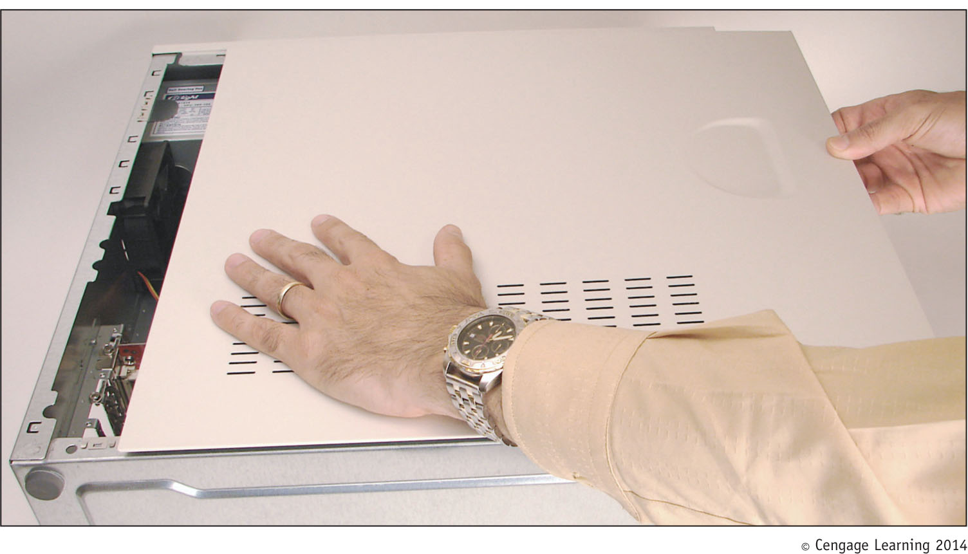
Figure 2-8 Slide the side panel to the front of the case
and then lift it off the case

Slide 14
Step 2: Open the Computer Case and Examine the System
Clip your ground bracelet to the side of the computer case
After opening you will see the main components:
Power supply
Motherboard
Drives
Trace cables from motherboard to the component to know the purpose of each cable

Slide 15
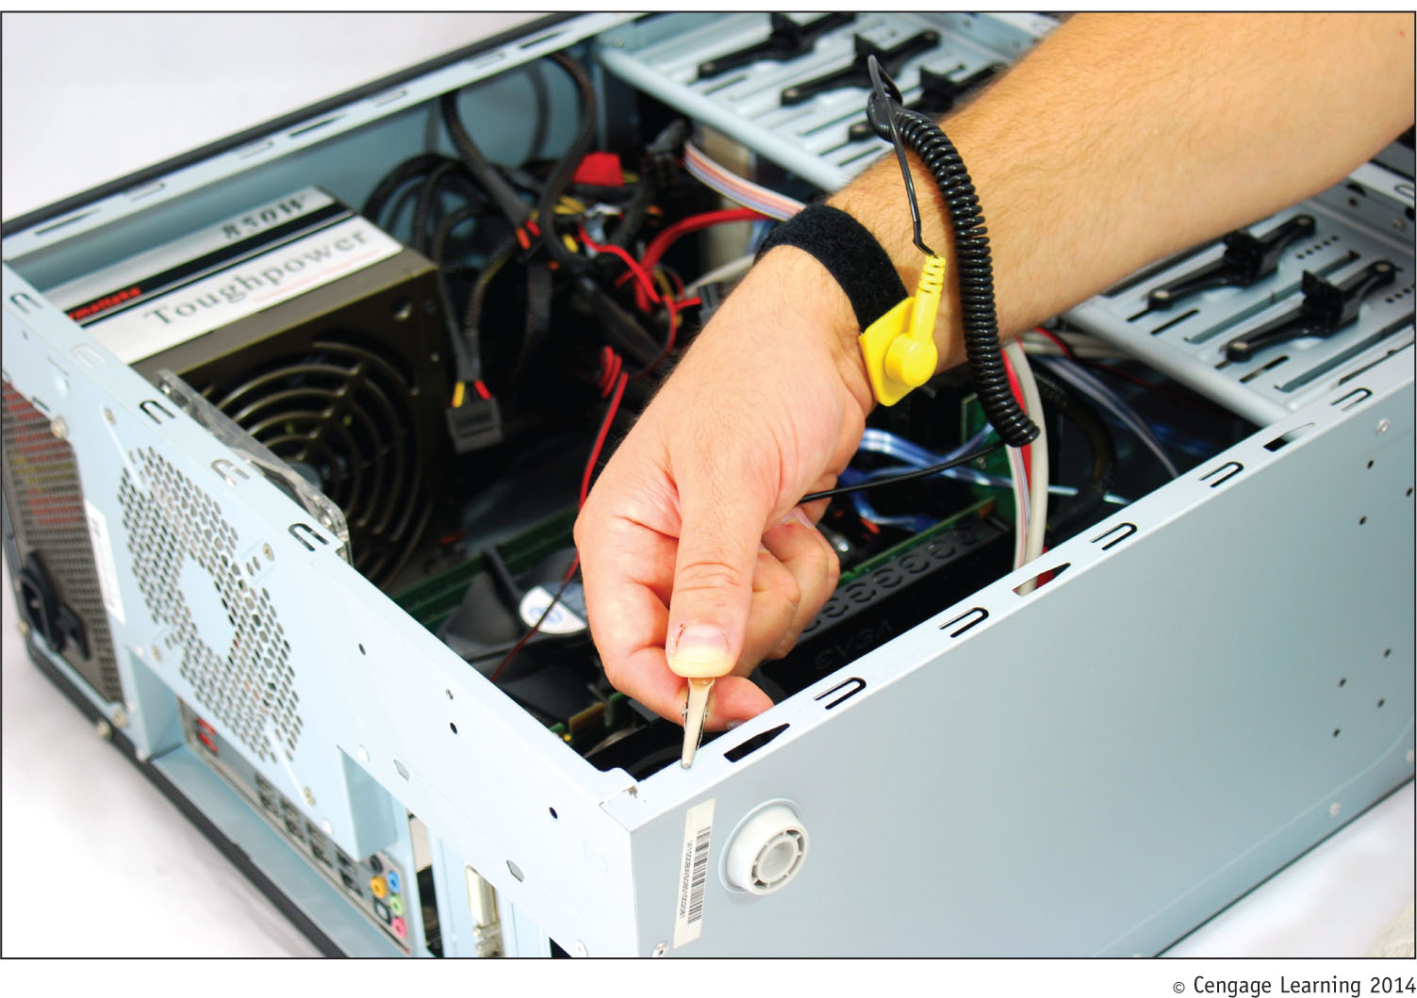
Figure 2-9 Attach the alligator clip of your ground bracelet
to the side of the computer case

Slide 16
Step 3: Remove Expansion Cards
If removing components:
Draw a diagram of all cable connections to the motherboard, expansion cards, and drives
Use a felt-tip marker to mark components in order to indicate a cable connection, board placement, orientation, etc..

Slide 17
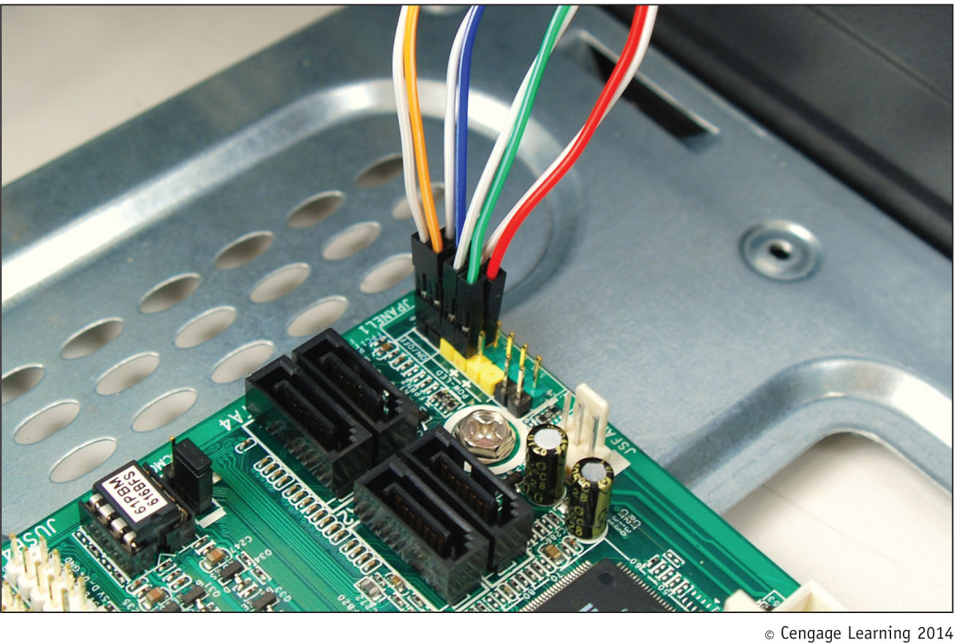
Figure 2-10 Diagram the pin locations of the color-coded
wires that connect to the front of the case

Slide 18
Step 3: Remove Expansion Cards
To remove expansion cards:
Remove any wire or cable connected to the card
Remove the screw holding the card to the case
Grasp the card with both hands and remove it by lifting straight up (can also rock the card from end to end)
Don’t put your fingers on edge connectors or touch a chip
It is best to store cards in an antistatic bag

Slide 19
Step 4: Remove the Motherboard, Power Supply, and Drives
Depending on the system, you may have to remove the drives and/or power supply to get to the motherboard
To remove motherboard:
Unplug power supply lines
Unplug PATA, SATA, and floppy drive cables
Disconnect wires leading from the front of the computer case to the motherboard (called front panel connectors)
Make a diagram before disconnecting

Slide 20
Step 4: Remove the Motherboard, Power Supply, and Drives
To remove motherboard (cont’d):
Disconnect any other cables or wires connected to the motherboard
Unscrew motherboard from spacers
Spacers (standoffs): round plastic or metal pegs that separate the board from the case
Spacers are necessary to keep motherboard from touching the metal case, which might cause a short
Motherboard should be free to remove from the case

Slide 21
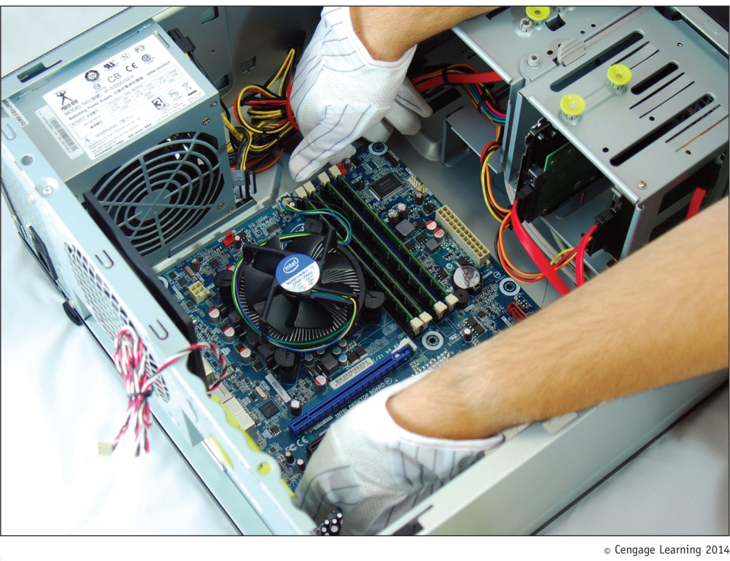
Figure 2-16 Remove the motherboard from the case

Slide 22
Step 4: Remove the Motherboard, Power Supply, and Drives
To remove the power supply from the case:
Look for screws that attach the power supply to the computer case
Do not remove screws that hold power supply housing together (do take housing apart)
Sometimes power supplies are also attached to the case on the underside by recessed slots
Turn case over and look for slots
If present, determine in which direction you need to slide the power supply to free it from the case

Slide 23
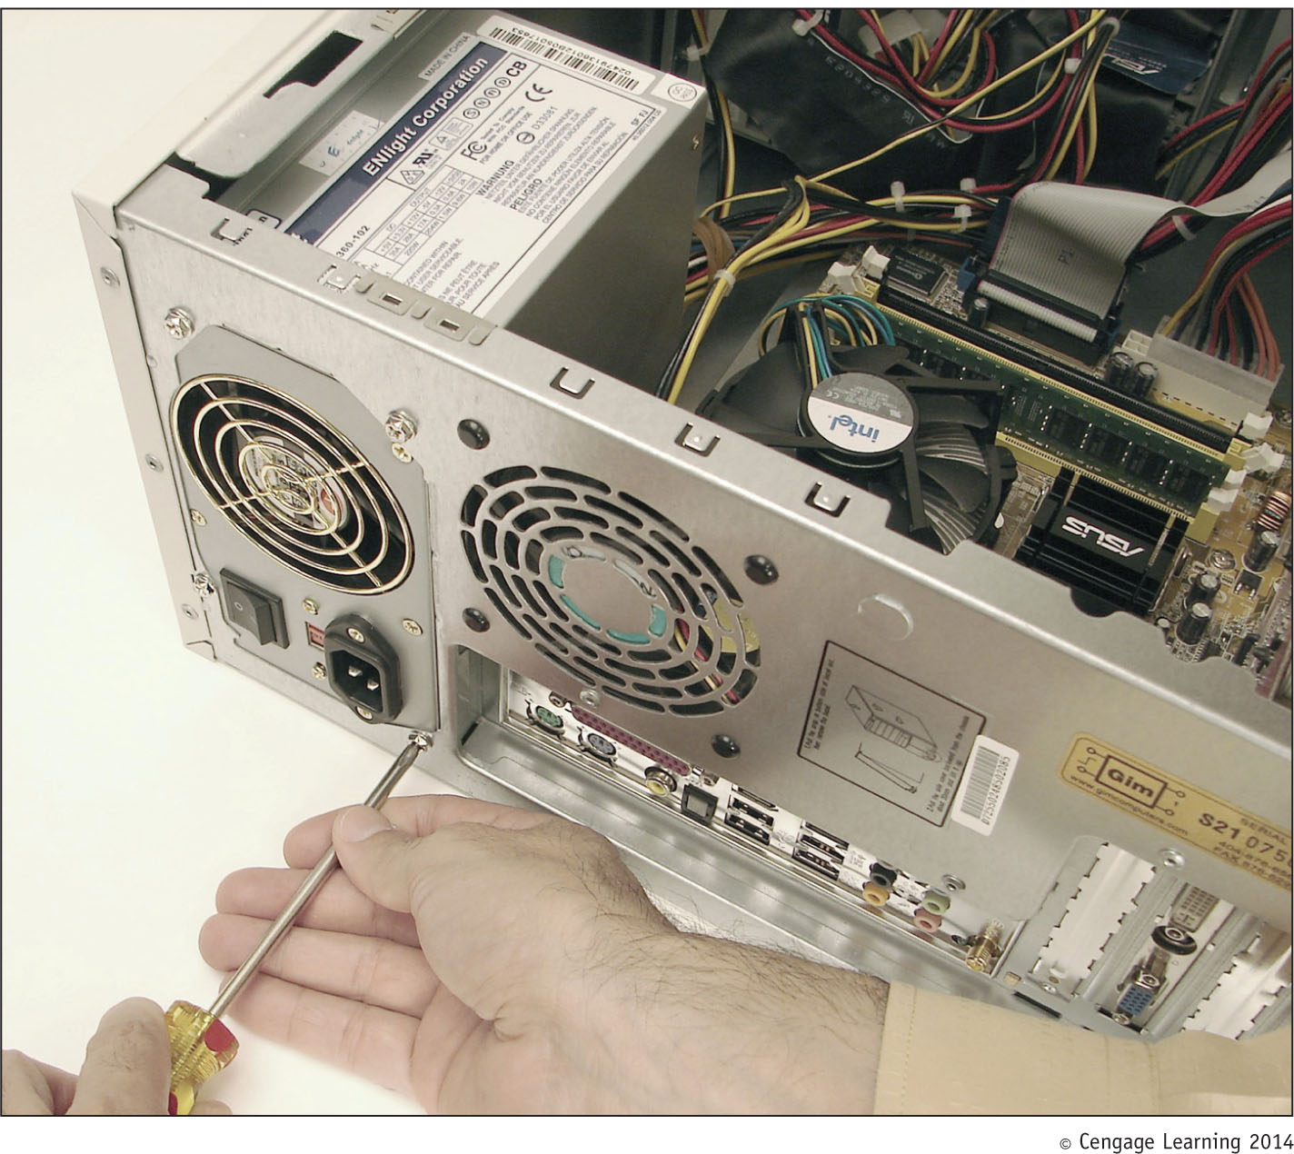
Figure 2-17 Removing the power supply mounting screws

Slide 24
Step 4: Remove the Motherboard, Power Supply, and Drives
Tips to remove drives:
Look for screws on each side of the drive attaching the drive to the drive bay
There might be a catch underneath the drive
You must lift up as you slide the drive forward
Some drive bays have a clipping mechanism to hold the drive in the bay
Release the clip and then pull the drive forward
May have to remove the drive bay in order to remove the drives

Slide 25
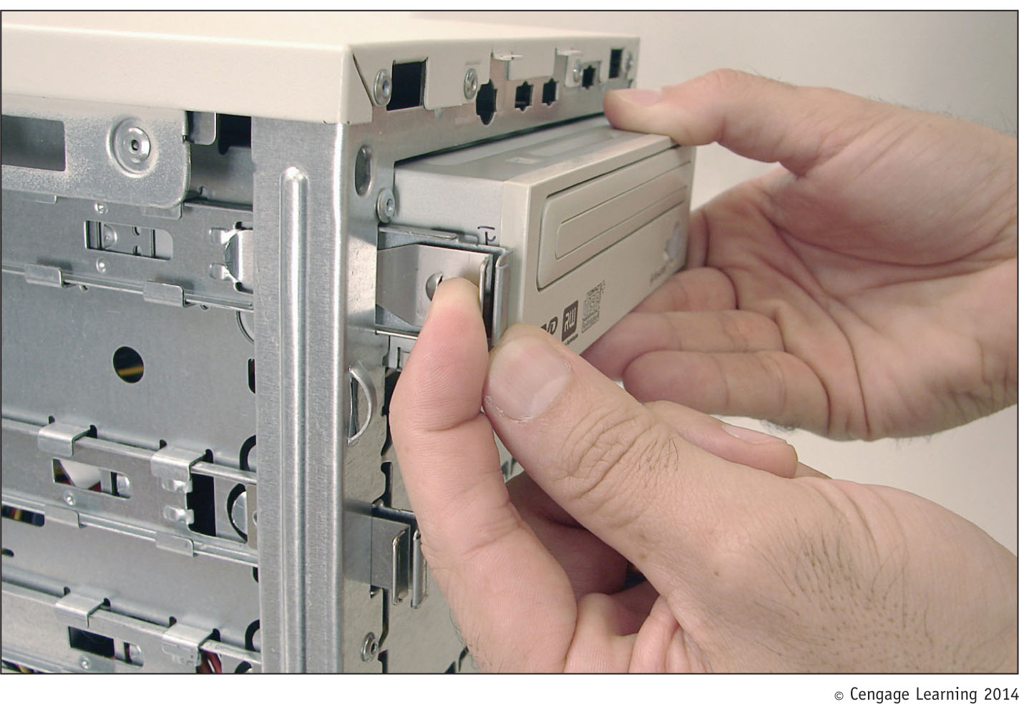
Figure 2-18 To remove this CD drive, first pull the clip forward to
release the drive from the bay

Slide 26
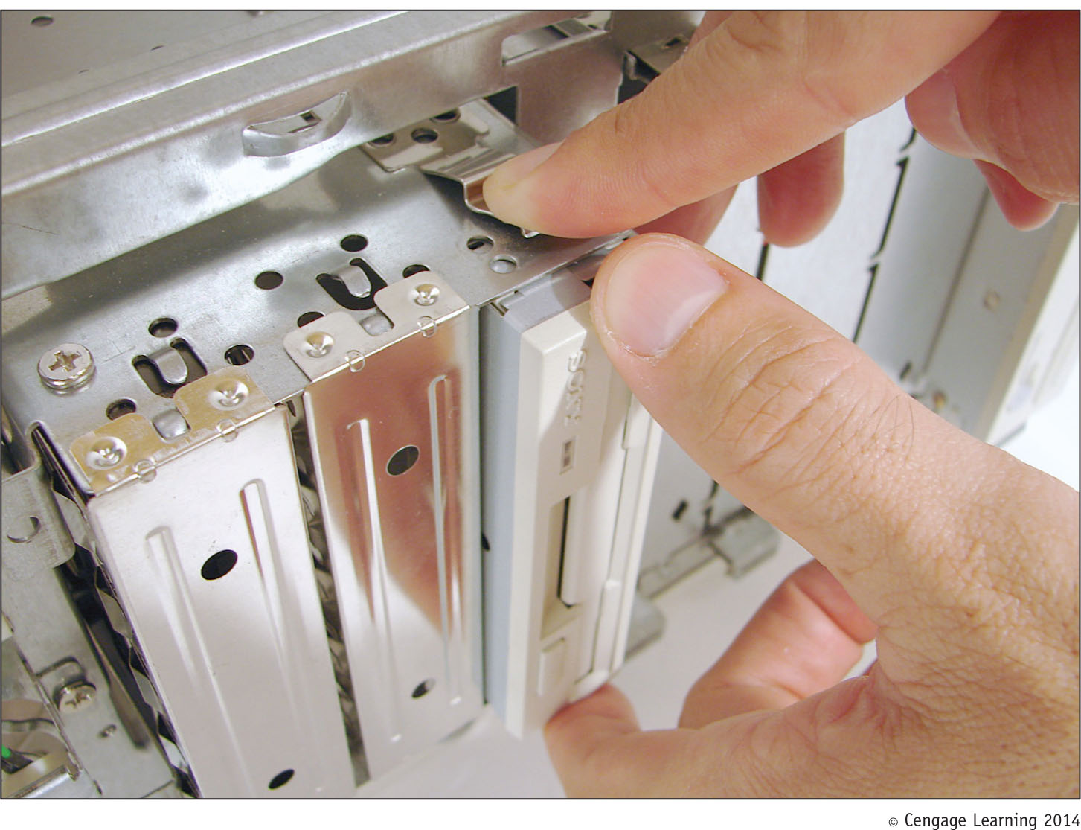
Figure 2-19 Push down on the clip and then slide the removable
bay forward and out of the case

Slide 27
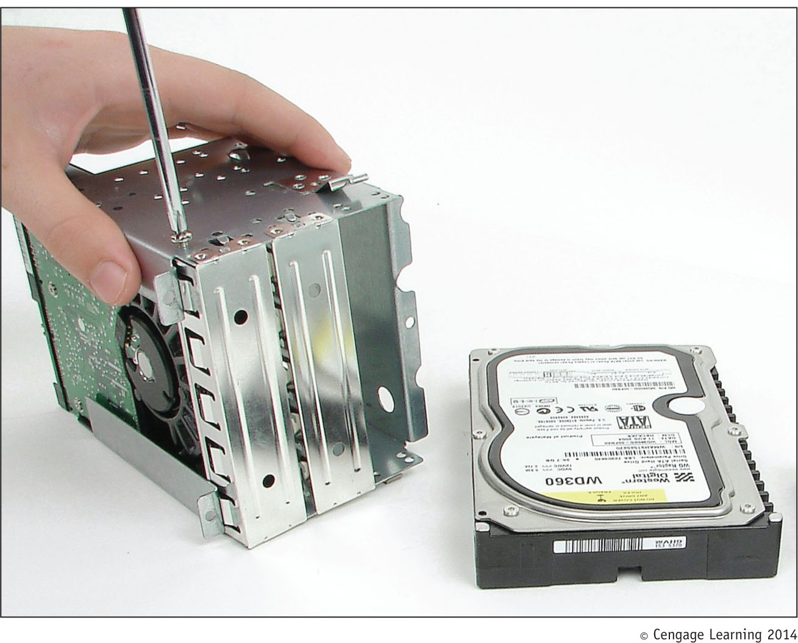
Figure 2-20 Drives in this removable bay are held in place
with screws on each side of the bay

Slide 28
Steps to Put a Computer Back Together
Refer to any diagrams created during the disassembling process
Install components in this order: power supply, drives, motherboard, and cards
When installing drives, it may be easier to connect cables to the drives before sliding them into the bay
Place motherboard inside the case
Make sure ports and screw holes are lined up

Slide 29
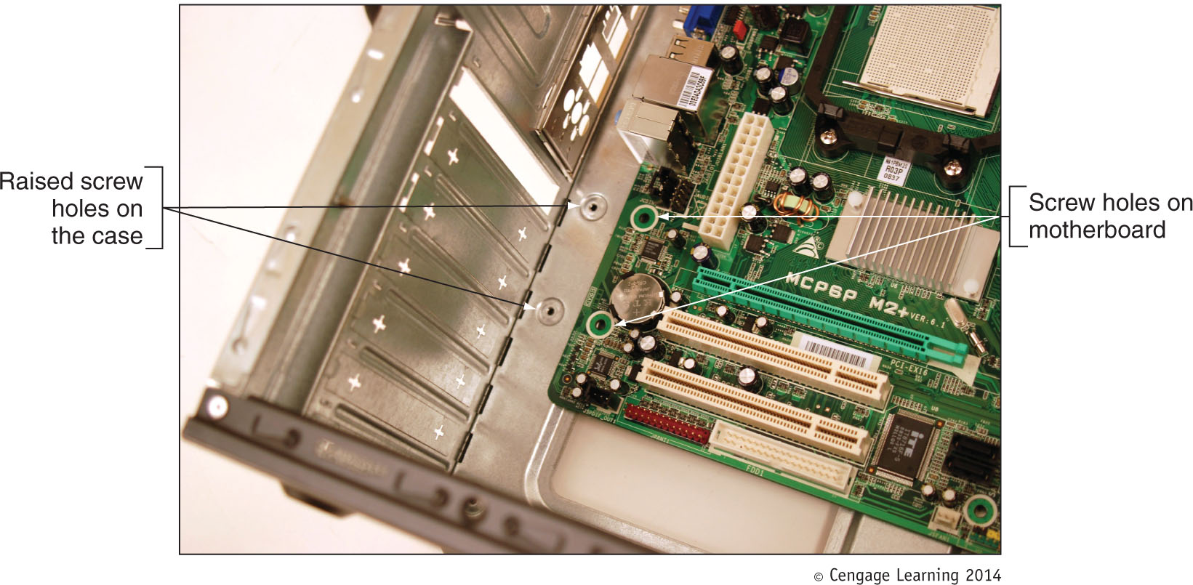
Figure 2-22 Align screw holes in the case with those on the motherboard

Slide 30
Steps to Put a Computer Back Together
Connect the power cords from the power supply to the motherboard
Will always need the main P1 power connector and may likely need the 4-pin auxiliary connector for the processor
A board might have a 6-pin or 8-pin PCIe power connector
If power supply does not have this connector, use an adapter to convert two Molex connectors to a PCIe connector

Slide 31
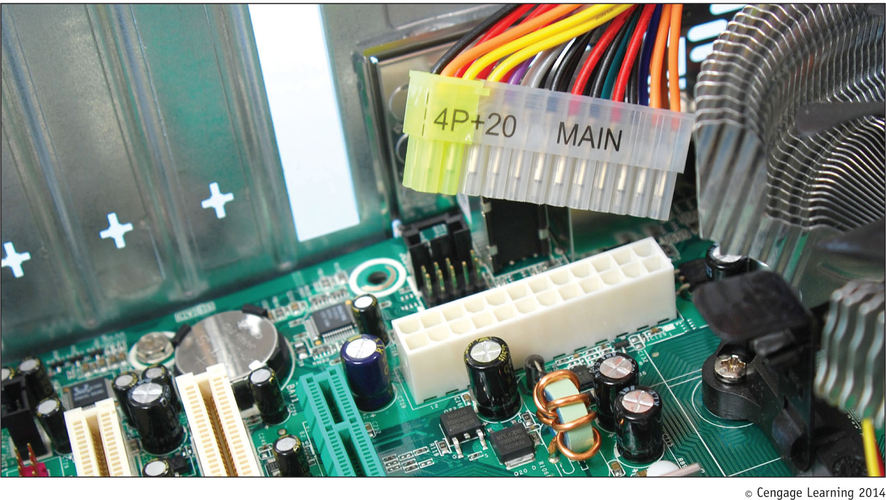
Figure 2-24 The 24-pin connector supplies power to the motherboard

Slide 32
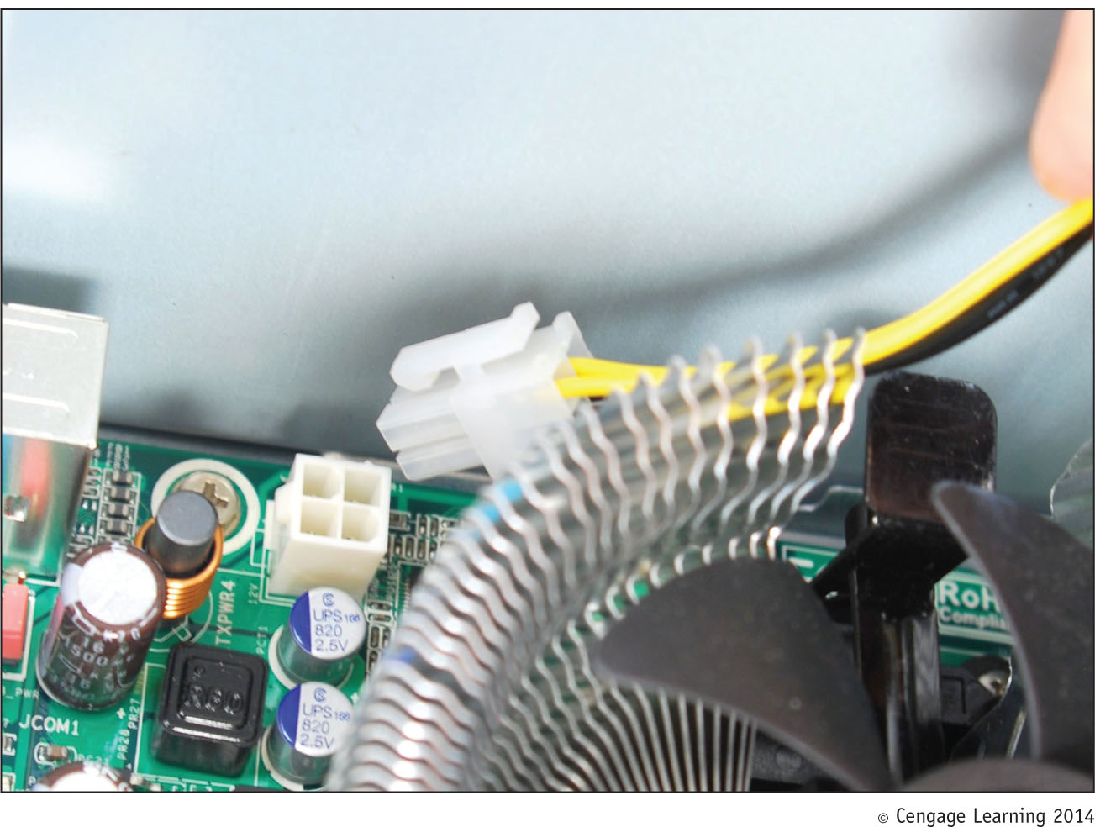
Figure 2-25 The auxiliary 4-pin power cord provides power to the processor

Slide 33
Steps to Put a Computer Back Together
Connect the power cords from the power supply to the motherboard (cont’d):
If case fan is present, connect power cord from the fan to pins on motherboard labeled “Fan Header”
If a CPU and cooler are already installed on motherboard, connect power cord from CPU to pins on motherboard labeled “Fan Header”
Connect wire leads from the front panel of the case to the front panel header on motherboard

Slide 34
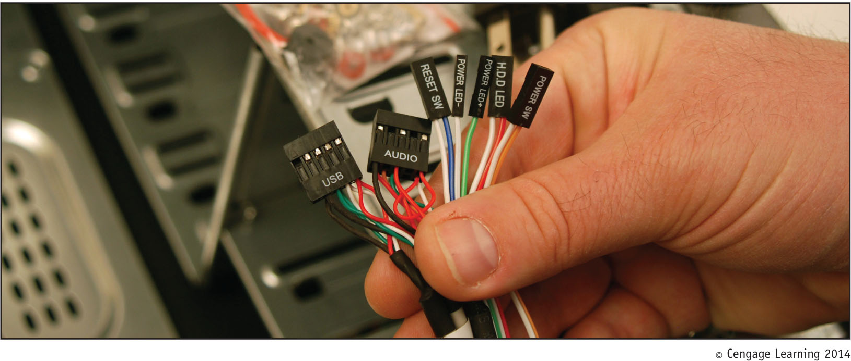
Figure 2-28 Seven connectors from the front panel connect to the motherboard

Slide 35
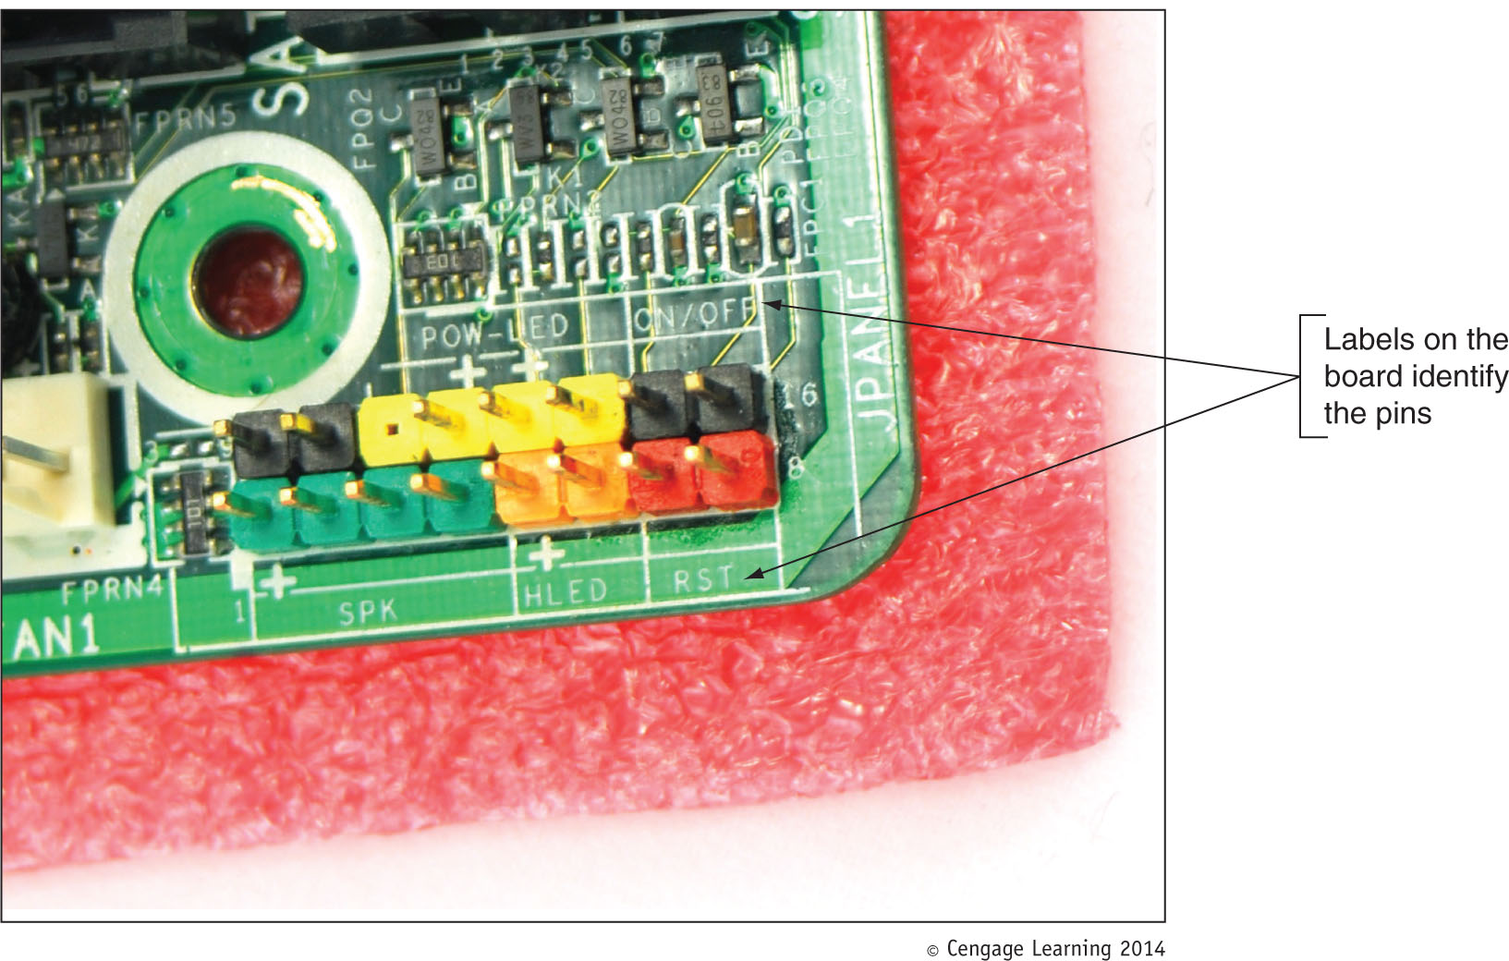
Figure 2-29 Front panel header uses color-coded pins and labels

Slide 36
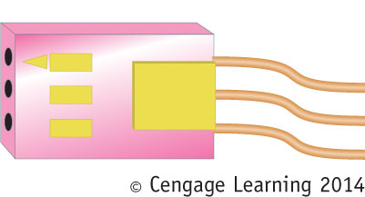
Steps to Put a Computer Back Together
Look for a small triangle embedded on the connector that marks one of the outside wires as pin 1
Line up pin 1 on connector with pin 1 marked on motherboard
If labels on motherboard are not clear, consult user guide for help
Figure 2-30 Look for the small triangle embedded
on the wire lead connectors to orient the connector
correctly to the motherboard connector pins

Slide 37
Steps to Put a Computer Back Together
Connect wires to ports on the front panel of the case
Audio ports or USB ports are examples
Install the video card and other expansion cards
Double-check each connection
Plug in keyboard, monitor, and mouse
In classroom environment, have instructor check work
Turn on the power and check that the PC is working properly
If not, most likely a loose connection

Slide 38
Cooling Methods and Devices
If processor, expansion cards, and other components overheat:
System can get unstable
Components can fail or be damaged
Devices used to cool a system:
CPU and case fans
Coolers
Heat sinks
Liquid cooling systems
Dust-preventing tools

Slide 39
Processor Coolers, Fans, and Heat Sinks
Intel maximum heat limit:
185 degrees F/85 degrees C
Good processor coolers maintain a temperature of:
90-110 degrees F (32-43 degrees C)
Cooler: sits on top of processor
Consists of a fan and heat sink
Heat sink: uses fins that draw heat away from processor
Fan: blows drawn heat away from CPU unit

Slide 40
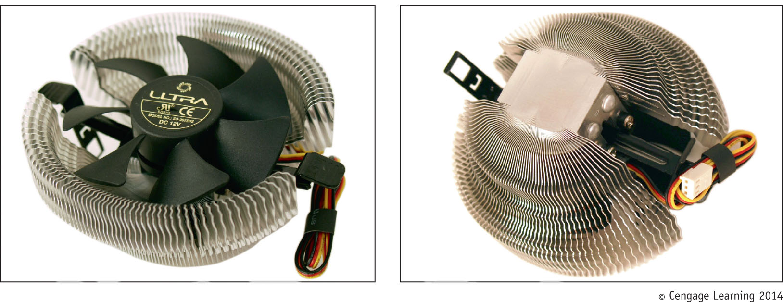
Figure 2-35 A cooler sits on top of a processor to help keep it cool

Slide 41
Processor Coolers, Fans, and Heat Sinks
Cooler (cont’d):
Made of aluminum, copper or combination of both
Bracketed to motherboard using a wire or plastic clip
A creamlike thermal compound eliminates air pockets, helping to draw heat off the processor
Found between bottom of cooler heatsink and top of processor
Makes an airtight connection between fan and processor
Gets power using a 4-pin fan header on the motherboard

Slide 42
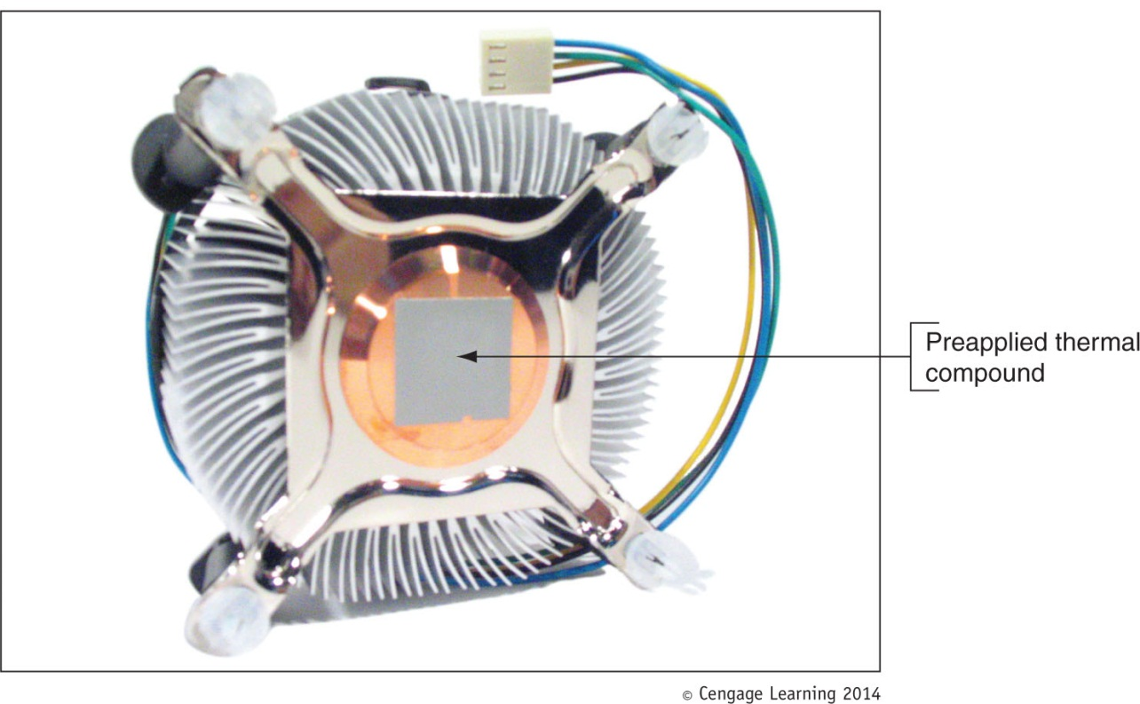
Figure 2-37 Thermal compound is already stuck to the bottom of this
cooler that was purchased boxed with the processor

Slide 43
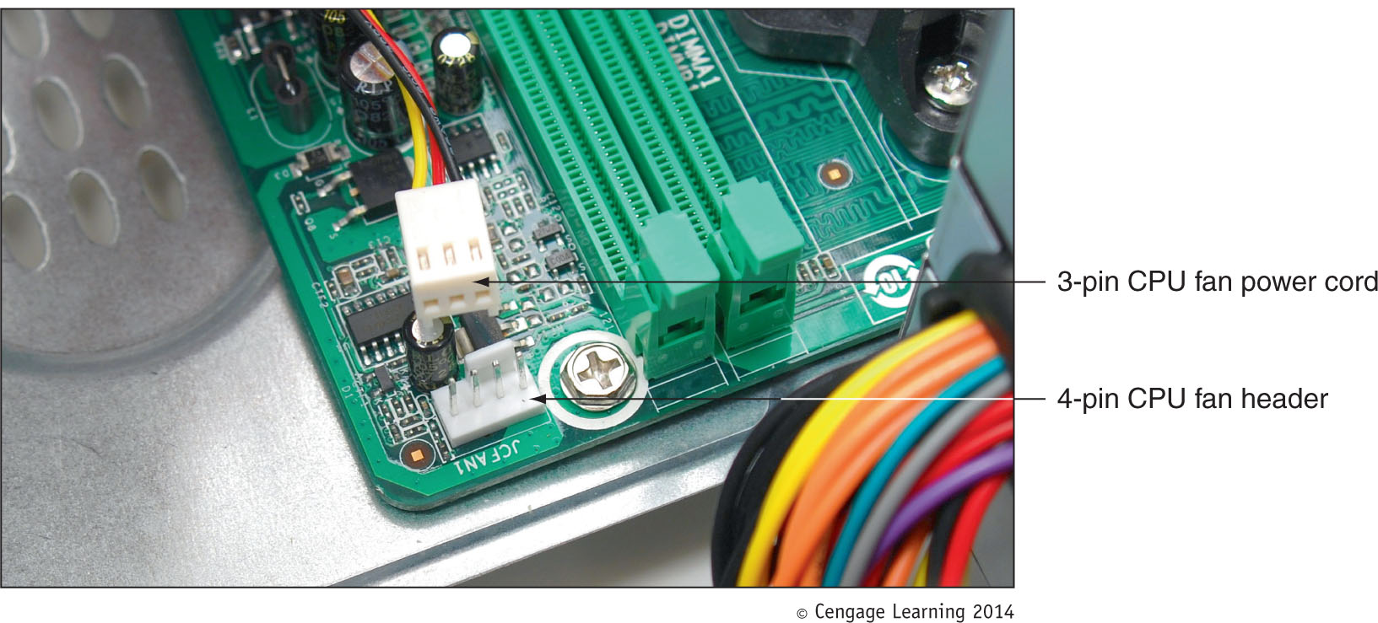
Figure 2-38 A cooler fan gets its power from a 4-pin PWM
header on the motherboard

Slide 44
Case Fans and Other Fans and Heat Sinks
Case fans: help draw air out of the case to prevent overheating
Most cases have one or more positions on the case to hold a case fan
Large fans tend to perform better than small fans
Other fans:
Some graphics (video) cards come with a fan
Fan cards can be mounted next to graphics cards
Be sure to select a fan card that fits the expansion slot you plan to use

Slide 45
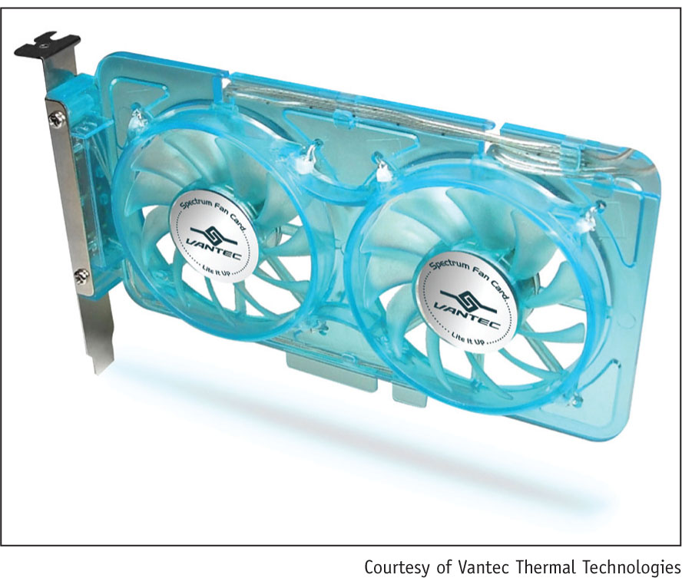
Figure 2-40 A PCI fan card by Vantec can be used next to a
high-end graphics card to help keep it cool

Slide 46
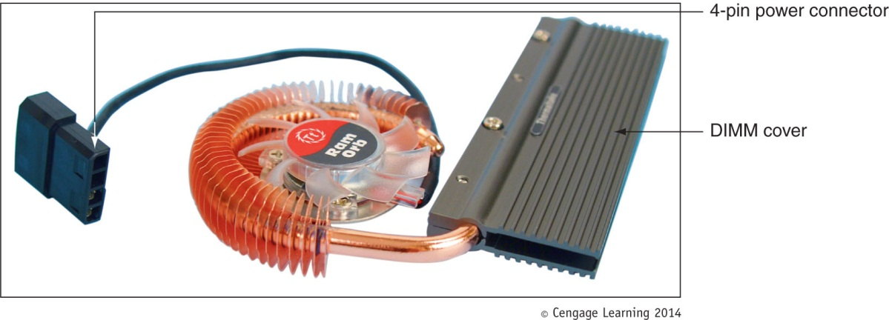
Case Fans and Other Fans and Heat Sinks
Other fans (cont’d):
RAM cooler – clips over a DIMM memory module
May be powered by a SATA or 4-pin Molex power connector
Figure 2-41 A RAM cooler keeps memory modules cool

Slide 47
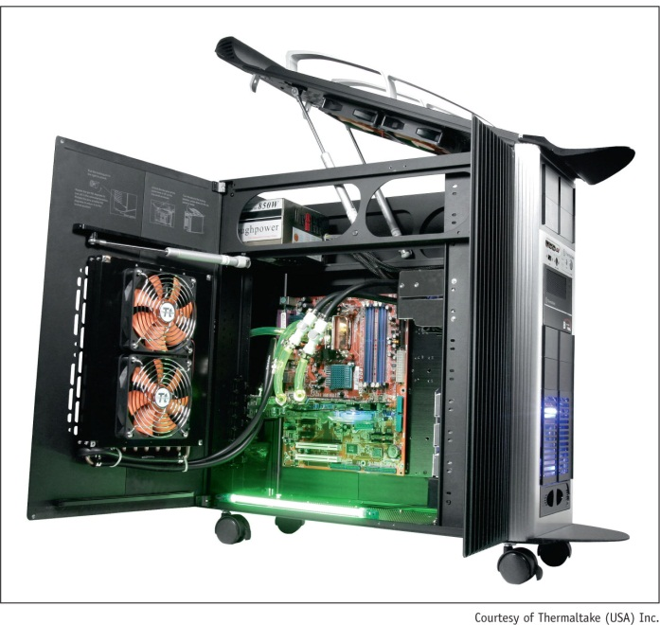
Liquid Cooling Systems
Liquid cooling system
A small pump sits inside the case and tubes moves liquid around components and then away from them to a place where fans cool the liquid
Figure 2-42 A liquid cooling system pumps
liquid outside and away from components
where fans can then cool the liquid

Slide 48
Dealing With Dust
Dust:
Insulates PC parts like a blanket causing overheating
Can jam fans which may also cause overheating
Dust can be blown out of the case using a can of compressed air or by using a antistatic vacuum
Should be part of a regular preventative maintenance program (at least twice a year)
Good idea to blow or vacuum keyboard as well

Slide 49
Selecting a Power Supply
Reasons to purchase a power supply:
Building a new system from scratch
Power supply in existing system fails
Power supply in existing system is not adequate
When building from scratch, some cases come with power supply already installed

Slide 50
Types and Characteristics of Power Supplies
Important power supply feature considerations:
Form factor determines power supply size
Wattage ratings (listed in documentation)
Type and number of power cables, and connectors
Fans inside the PSU
Warranty and overall quality

Slide 51
How to Calculate Wattage Capacity
Determining wattage capacity
Consider all components inside case
Consider USB and FireWire devices
Get power from ports connected motherboard
Points to keep in mind
Video cards draw the most power
Use power supply rated 30 percent higher than expected
What size Power Supply?
Add up wattage requirements and add 30 percent

Slide 52
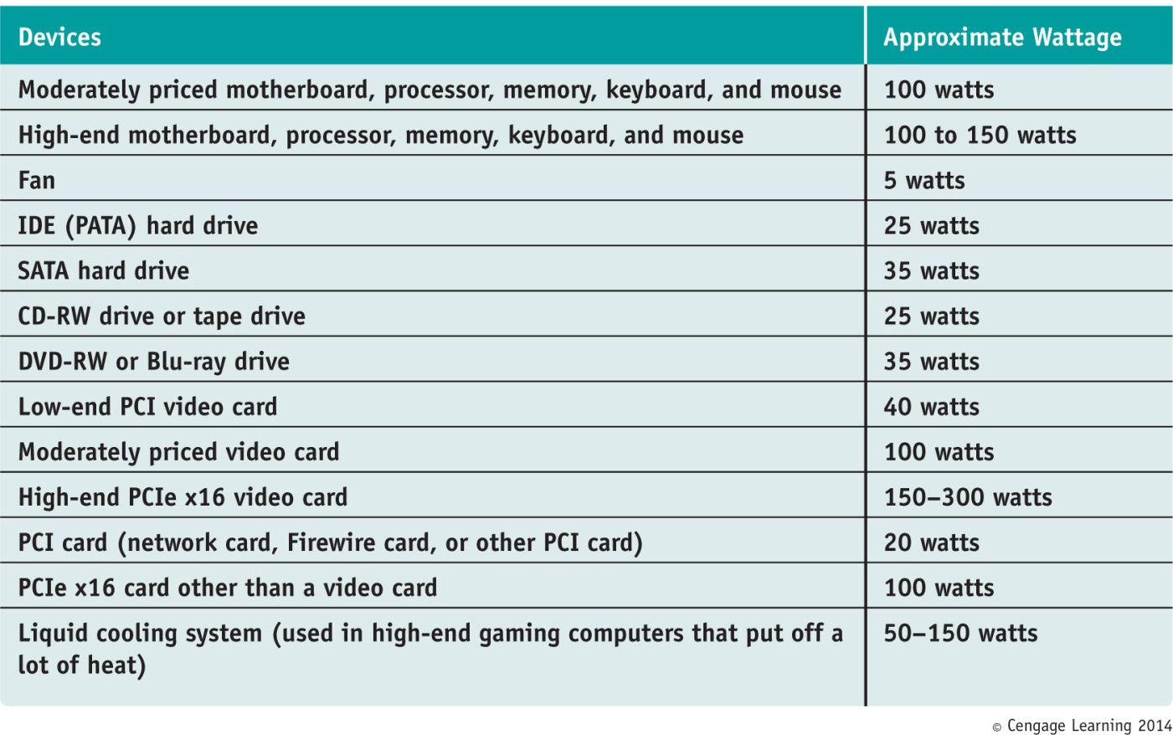
Table 2-1 To calculate power supply rating, add up total wattage

Slide 53
Summary
When working inside a computer, stay organized, keep careful notes, and follow all safety procedures
Before opening a case, shut down the system, unplug it, disconnect all cables, and press the power button to drain residual power
An expansion card fits in a slot on the motherboard and is anchored to the case by a single screw or clip
Devices used to keep a processor and system cool include CPU coolers, fans, heat sinks, and liquid cooling

Slide 54
Summary
Liquid cooling system use liquids pumped through system to keep it cool
Important features of a power supply to consider when purchasing it are: form factor, wattage capacity, number and type of connectors, fan size, support dual video cards, and warranty
To decide on the wattage capacity of a power supply, add up the wattage requirements for all components and add 30 percent

